Slide 1
Credit Risk Analysis Project
Kolar Nagaraja Rao, Ganesh Rao
Agrawal, Manyata
Azeem, Syed Omar

Slide 2
Executive Summary
Objective: Develop a data-driven Credit Default Risk Model to support smarter credit approval decisions using predictive modeling and AI-based strategies.
Strategy: We defined two key strategies—Conservative to minimize risk and Aggressive to maximize growth—each driven by default prediction probabilities from our model.
We recommend the Conservative strategy (Threshold = 0.1) as it maintains both a low default rate (<2%) and positive profit margin, meeting business risk appetite and stop-loss guidelines

Slide 3
Data
Category | # Observations | Default Rate
13 Months | 77,348 | 22.94%
12 Months | 2,115 | 37.87%
11 Months | 1,159 | 44.09%
10 Months | 1,329 | 46.58%
9 Months | 1,278 | 43.58%
8 Months | 1,169 | 45.08%
7 Months | 1,046 | 41.49%
6 Months | 1,109 | 41.30%
5 Months | 933 | 39.44%
4 Months | 938 | 43.07%
3 Months | 1,158 | 35.75%
2 Months | 1,217 | 31.22%
1 Month | 984 | 33.13%

Slide 4
Features
 | Category | Number of Features
1 | D_* = Delinquency variables | 96
2 | S_* = Spend variables | 22
3 | P_* = Payment variables | 3
4 | B_* = Balance variables | 40
5 | R_* = Risk variables | 28

Slide 5
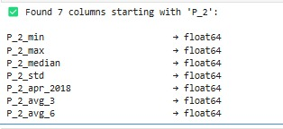
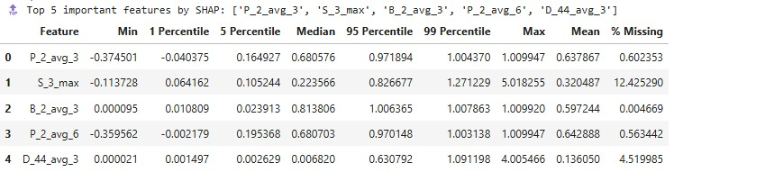
Feature Engineering
 | Category | # of Features
1 | *_min | 175
2 | *_max | 175
3 | *_median | 175
4 | *_std | 175
5 | *_apr_2018 | 175
6 | *_avg_3 | 175
7 | *_avg_6 | 175

Slide 6
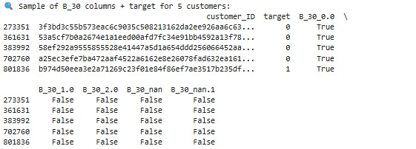
Data Processing- One Hot Encoding
categorical_vars = ['B_30', 'B_38', 'D_114', 'D_116', 'D_117', 'D_120', 'D_126', 'D_63', 'D_64', 'D_66', 'D_68'] df[categorical_vars] = df[categorical_vars].astype(str
df = pd.get_dummies(df, columns=categorical_vars, dummy_na=True)
Result – below is an example for 5 different customers, and the one hot encoded columns for B_30 column

Slide 7
Feature Selection
Initial XGBoost Model An XGBoost model was first trained using default parameters to analyze the relative importance of each feature in predicting the target variable.
Refined XGBoost Model To enhance predictive performance, the model was refined by setting the number of trees to 300, the maximum depth to 4, and the learning rate to 0.5. This adjustment provided deeper insights into feature importance and improved model accuracy.
Final Feature Selection Features with an importance score above 0.5% were selected and compiled into a final feature set. This step ensures that only the most relevant variables are retained, contributing to the development of a more efficient and accurate predictive model.
 | Category | # of Features | # selected
1 | *_min | 175 | 1
2 | *_max | 175 | 2
3 | *_median | 175 | 1
4 | *_std | 175 | 0
5 | *_apr_2018 | 175 | 0
6 | *_avg_3 | 175 | 7
7 | *_avg_6 | 175 | 6
Selected_Features –
D_42_min, D_42_max, S_3_max, D_48_median, B_1_avg_3, B_2_avg_3, B_9_avg_3, B_11_avg_3, D_44_avg_3, P_2_avg_3, R_1_avg_3, D_42_avg_6, D_44_avg_6, D_48_avg_6, D_49_avg_6, P_2_avg_6, R_1_avg_6

Slide 8
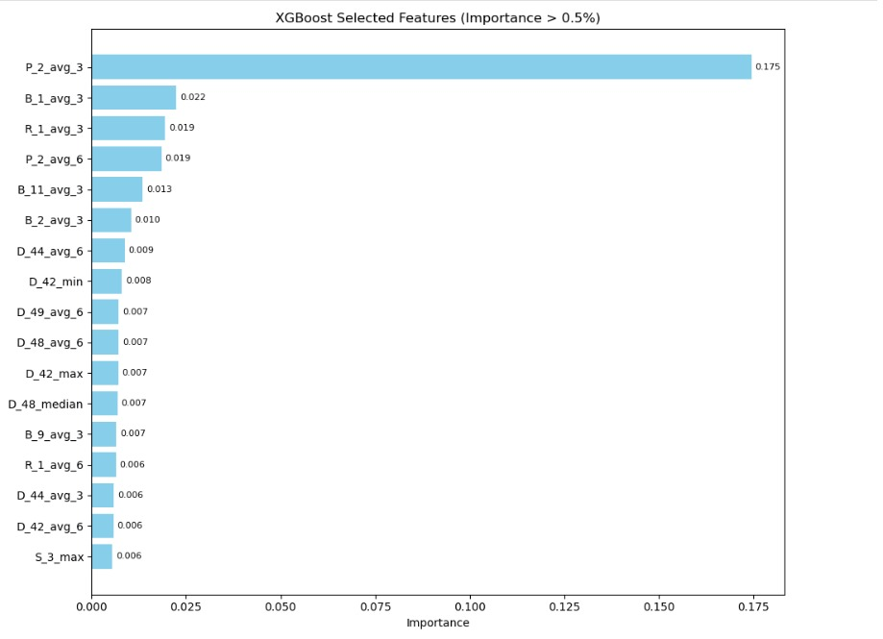

Slide 9
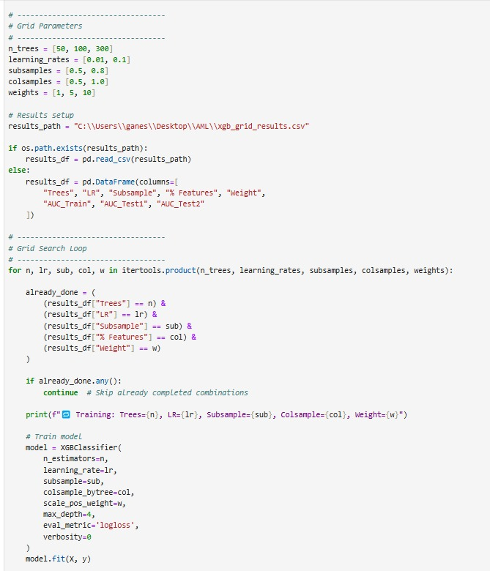
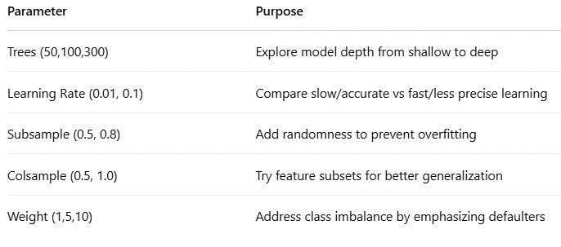
XGBoost- Grid Search
Lessons learned
Some models overfit: very high AUC on Train, but lower on Test1
scale_pos_weight = 5 gave the best balance (improved Test1 AUC)
Adding more trees led to marginal AUC gain but longer training time
learning_rate = 0.1 worked best with deeper trees
Class imbalance was handled well with scale_pos_weight tuning

Slide 10
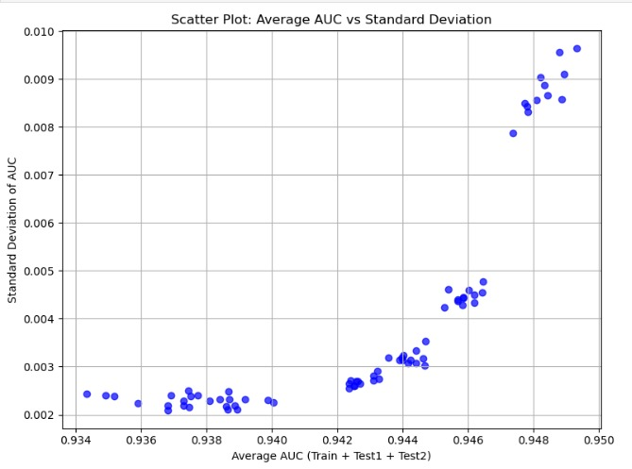
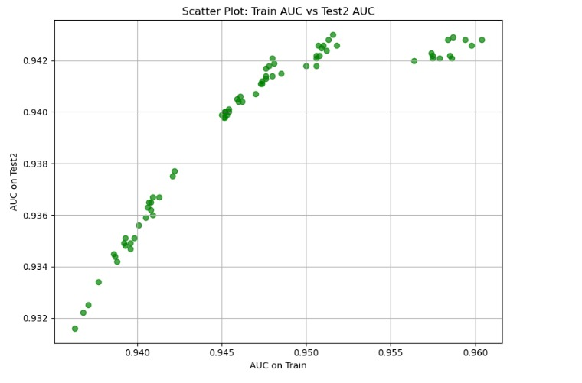
XGBoost- Grid Search

Slide 11
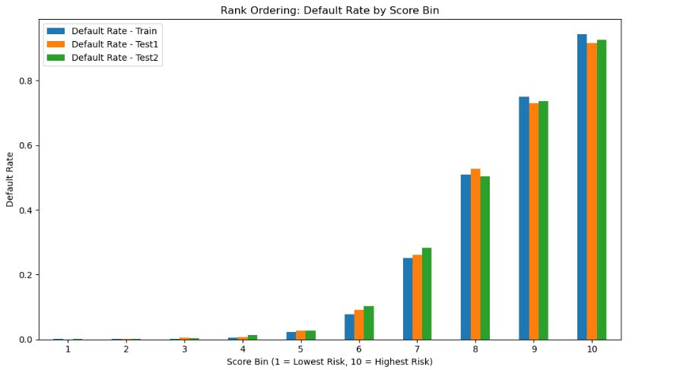
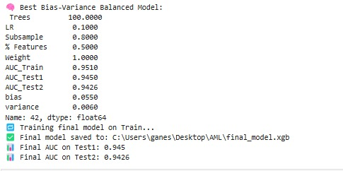
XGBoost- Final Model

Slide 12
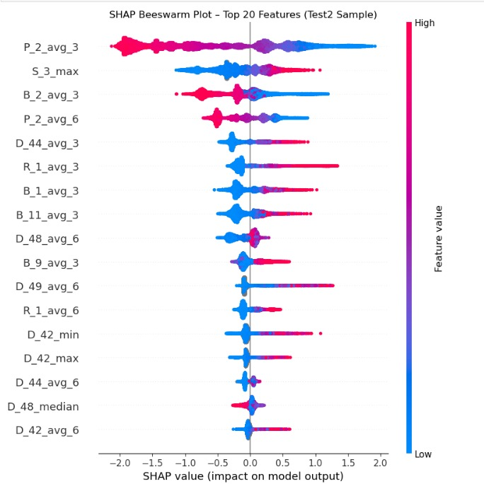
XGBoost- SHAP Analysis
P_2_avg_3 (3-month average of P_2) is the strongest predictor — higher values significantly increase default risk.
Behavioral Insight: Features like S_3_max and B_2_avg_3 also raise default probability when high, suggesting risky recent spending and balance patterns.
Inverse Patterns: Lower values of D_44_avg_3, R_1_avg_3, and B_1_avg_3 are associated with increased risk — indicating certain low usage or behavior flags risk.
Temporal Comparison: 3-month (_avg_3) versions of features generally have more predictive power than 6-month (_avg_6) averages.

Slide 13
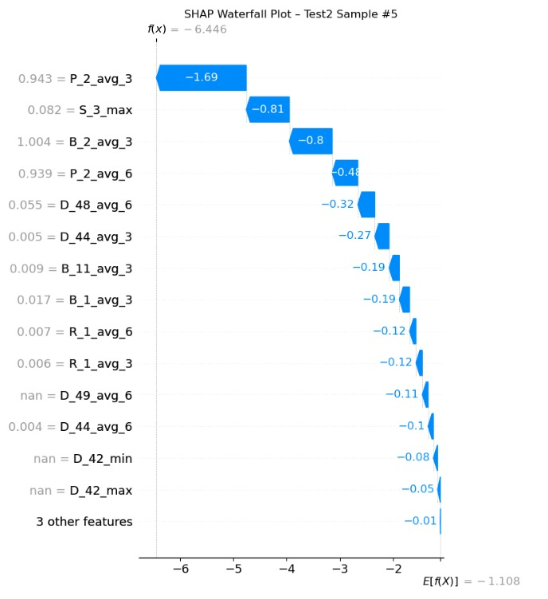
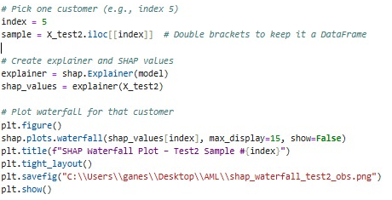
XGBoost- SHAP Analysis
P_2_avg_3 (recent payment behavior) has the strongest impact, significantly reducing the predicted risk of default.
Features like B_2_avg_3 (balance) and S_3_max (spend spikes) also help classify the customer as low risk.
The cumulative effect of top features pulls the model output from -1.11 (average) to -6.45, indicating high creditworthiness.
The plot explains exactly which features drive the prediction, enabling transparent and actionable decisions.

Slide 14
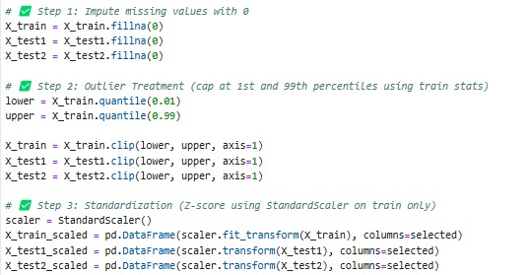
Neural Network- Data Processing
All missing values in the dataset were imputed with 0, assuming they represent absence or zero activity.
Outliers were capped at the 1st and 99th percentiles using statistics from the training set to ensure model stability and prevent skewed learning.
We used StandardScaler to apply Z-score normalization, fitting on the train set only and applying to test sets to avoid data leakage.

Slide 15
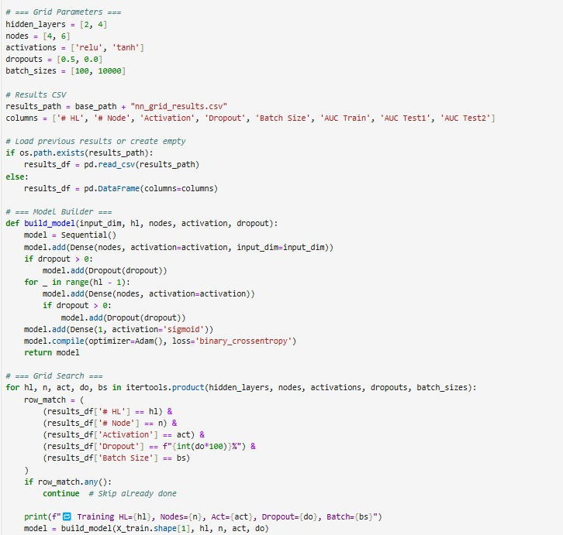
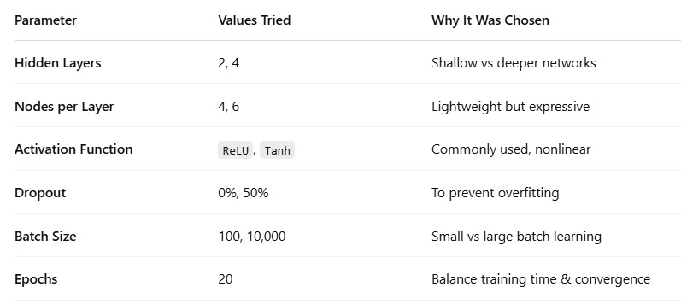
Neural Network- Grid Search
Overfitting Risk: Models with no dropout and ReLU activation overfitted more — high AUC on train but much lower on test sets.
Best Balance: A configuration with 4 hidden layers, 6 nodes, Tanh, 50% dropout, and batch size 100 gave the most balanced AUCs.
Batch Size Impact: Smaller batch sizes (100) generally led to better generalization than 10,000.
Tanh Outperformed ReLU: In several cases, Tanh activation gave better stability and less variance across test sets.

Slide 16
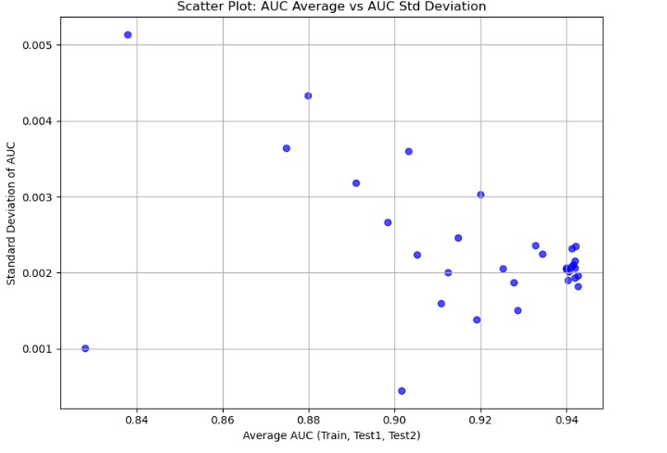
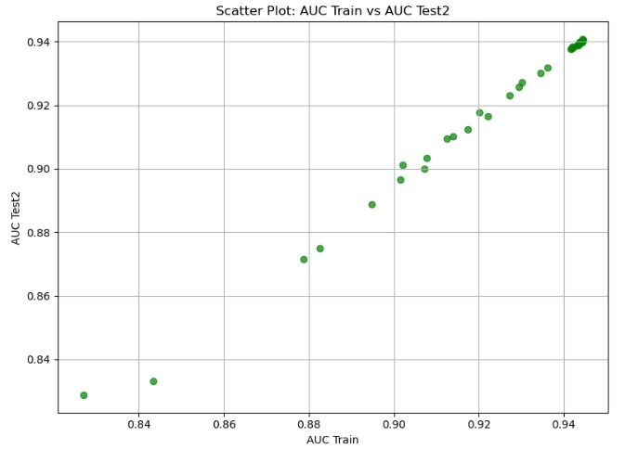
Neural Network- Grid Search

Slide 17
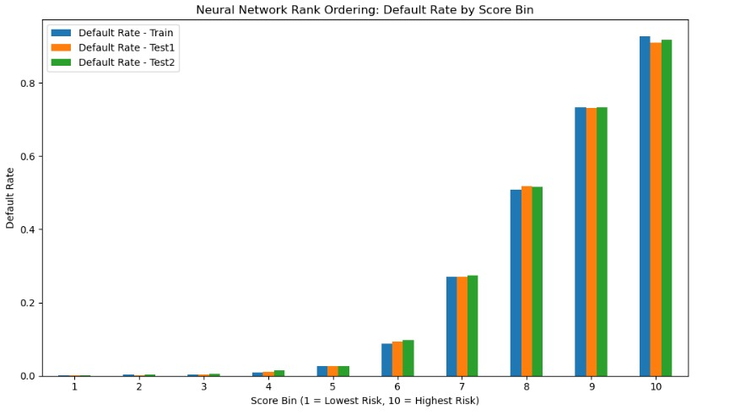
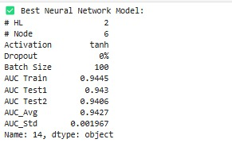
Neural Network- Final Model

Slide 18
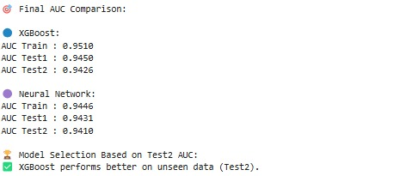
Final Model
XGBoost was chosen as the final model because it achieved the highest Test2 AUC of 0.9426, indicating better generalization to unseen data compared to the Neural Network (Test2 AUC = 0.9410).
While both models performed well on Train and Test1, XGBoost maintained a stronger balance between bias and variance across all datasets.
The Neural Network slightly overfit, with a higher AUC on Train (0.9446) but slightly lower generalization on Test2.
The AUC comparison table and chart (shown above) clearly support this decision by showcasing XGBoost’s superior performance on the final evaluation sample.

Slide 19
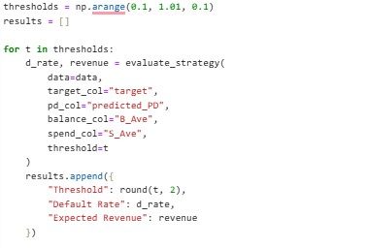
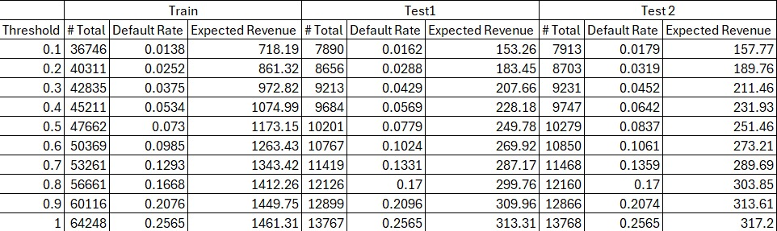
Strategy

Slide 20
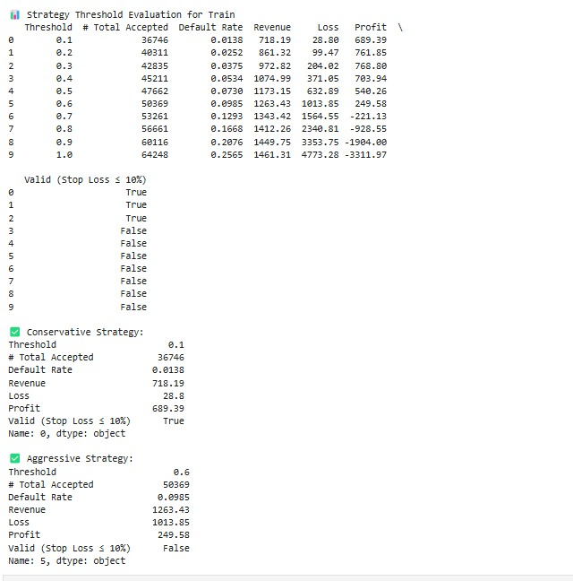
Strategies
We defined conservative and aggressive strategies based on stop-loss and default thresholds, selecting optimal strategies to balance profit and risk.
Conservative Strategy: Threshold 0.1 was chosen for its low default rate and minimal loss, ensuring stop-loss remains under 10%
Aggressive Strategy: Threshold 0.6 allows broader acceptance with default rate below 10%, offering higher revenue while slightly exceeding stop-loss

